Slide 1
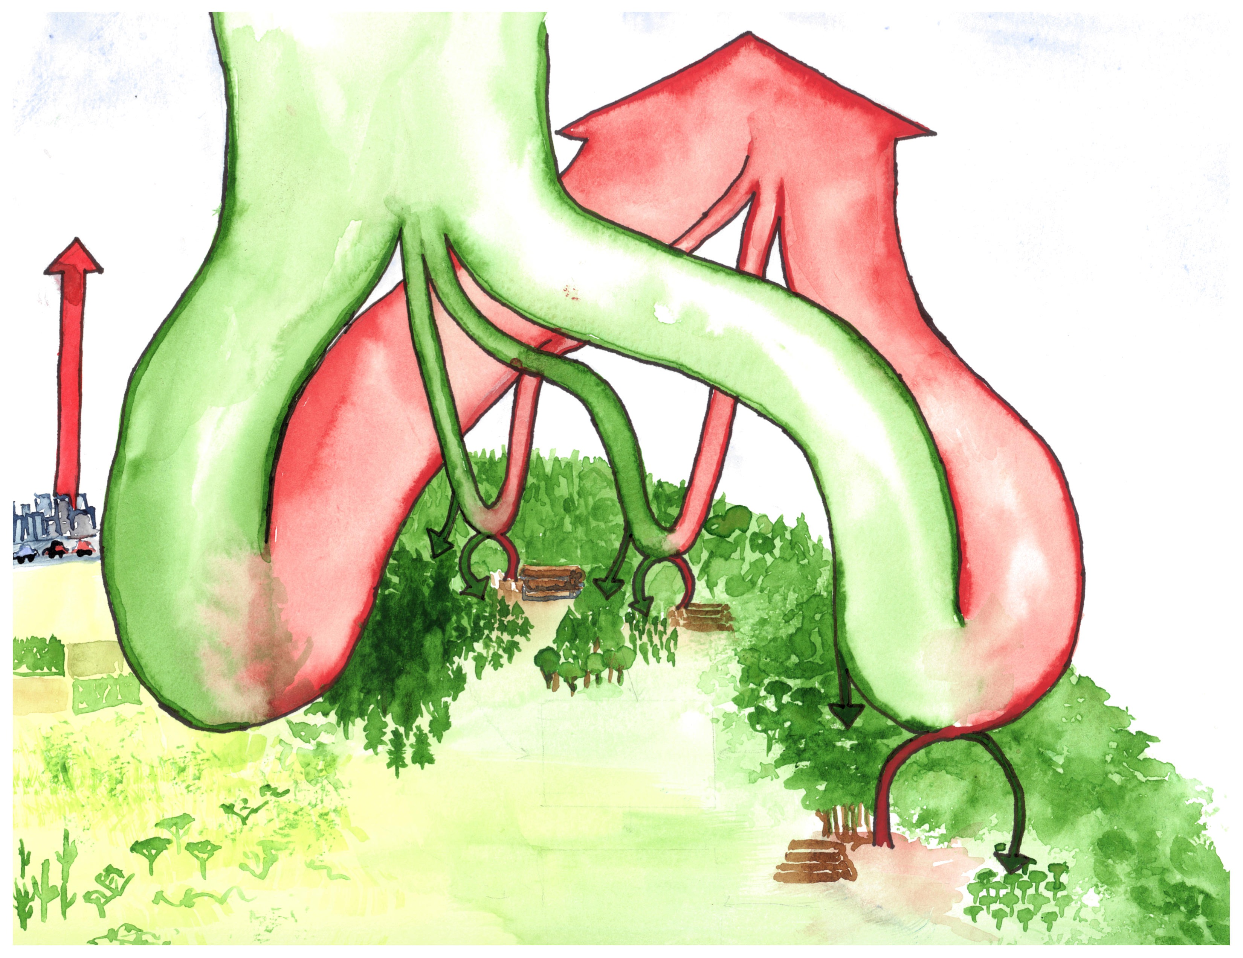
ecosystem respiration + fire
atmosphere
873
gross primary production
Fluxes Gt C yr⁻¹
Stocks Gt C
-121.6
+120.4
fossil fuels
+9.4
+62.6
+7.8
+40.9
+9.1
-62.6
-40.8
-8.3
-9.9
boreal forests
temperate forests
non-forest
biomass 54-88
biomass 47-59
tropical forests
-0.5
-0.8
intact forest sink
-2.3
-1.0
biomass
211-262
biomass
31-107
deforestation +2.8
regrowth
-1.7
net terrestrial sink
-1.2
net deforestation
+1.1
Notes:
Values apply to the period 2000-2018. Sources include the following: biomass: IPCC 2000, Baccini et al 2012, Pan et al. 2013; GPP: (Beer et al 2010); intact forest sink: Pan et al. 2011; tropical deforestation and regrowth: Pan et al. 2011; net terrestrial sink: Pan et al. 2011; respiration+fire: calculated based on others; fossil fuel emissions: Le Quere et al 2017; atmospheric CO₂ (current; https://scripps.ucsd.edu/programs/keelingcurve/).

